Slide 1

Year: IV & Semester: VII Alliance School of Advanced Computing Department of CSE-IT
CAPSTONE PROJECT - 1

Slide 2

Title of the Project: Advanced vitamin deficiency detection using deep learning
Sl. No | Reg. No | Student Name | Program | Guide Name | Date of Review
1 | 2022BCSE07AED477 | B JAYA HARSHITHA REDDY | CSE-AIML | Dr . RC Karpagalakshmi | 25-10-2025
2 | 2022BCSE07AED475 | KUMMATHI SUSMITHA | CSE-AIML
3 | 2022BCSE07AED472 | MATTEDDULA KEERTHI | CSE-AIML
4 | 2022BCSE07AED172 | B BHARGAV KUMAR REDDY | CSE-AIML

Slide 3
Agenda
Project Title
Abstract
Problem Statement
Objectives
Methodology
Implementation Details
Results (if available)
Tools & Technologies
Hardware & Software Requirements
Research Paper Status
· Industrial Collaboration (if any)
· PPT Link (Updated till date)
· Proof Links (Paper Submission / Hackathon if available)

Slide 4
Abstract
In today’s fast-paced lifestyle, vitamin deficiencies have become a common health concern, affecting a large portion of the population. Early detection is essential to prevent severe complications and enhance overall healthcare outcomes. To address this issue, the project introduces a hybrid CNN-ANN architecture-based detection framework. The CNN component is used for image classification because of its superior feature extraction capabilities and strong performance in visual recognition tasks, achieving an accuracy of about 90%. Meanwhile, the ANN processes textual and tabular data, offering robustness when working with incomplete or noisy medical information and performing well with sufficient training samples. The system collects images of eye color, nails, and pale skin and analyzes them through the CNN and ANN models to accurately identify potential vitamin deficiencies. This integrated approach ensures reliable and efficient detection, making the system both effective and practical for real-world problems

Slide 5
Introduction
vitamin deficiencies such as A, B12, C, D, Iron, folate have become increasingly common causing severe issues due to the lifestyle changes, unbalanced diet plans, climate changes, lack of early detection and limited access to healthcare facilities. It is important to detect these deficiencies to prevent severe health problems, complications and to improve the health care. The most common deficiencies are Vitamin A, B12, D, iron, iodine and calcium deficiencies which will affect the most of the population and cause variety of diseases and disabilities. If the deficiencies are not identified early can lead to severe complications like complete blindness, memory loss, muscle weakness, heart failure, pregnancy related complications and dental problems. Early signs like pale nails, dry skin, white tongue, hair thinning, cracked lips are commonly ignored until it becomes severe. Traditional diagnostic methods heavily depends on laboratory blood tests which are very expensive, time consuming, not easily accessible in many regions like remote areas, low-income populations and rural areas. With advancements in Artificial Intelligence, image-based, symptom-based prediction systems can make early detection of deficiencies, cheaper and easily accessible.

Slide 6
Problem Statement
Vitamin deficiencies such as A, B12, D, and E are common nutritional disorders that can lead to severe health issues. Current detection methods rely on invasive blood tests that are time-consuming, costly, and inaccessible to many populations.

Slide 7
Objectives
To develop an advanced deep learning model capable of detecting multiple vitamin deficiencies (A, B12, D, and E) through non-invasive methods using facial, nail, or eye images.
To implement Convolutional Neural Networks (CNNs) that can learn and classify visual features linked to specific vitamin deficiencies
To collect and preprocess image datasets showing visible signs of vitamin deficiencies for accurate model training and testing.
To design a cost-effective, accessible, and time-saving detection system that minimizes dependency on traditional blood tests.
To build a user-friendly interface or mobile application that provides instant vitamin deficiency predictions for real-world healthcare use.
To evaluate the model’s performance using key metrics such as accuracy, precision, recall, and F1-score to ensure reliability and efficiency.

Slide 8
Methodology
Step 1: Data Collection
Gather patient data such as blood test results, physical symptoms, demographic details, and medical images. This data provides the base for identifying vitamin deficiencies.
Step 2: Data Preprocessing
Clean and prepare the data by fixing missing values, scaling numbers, and formatting text or images. Ensures data is consistent and ready for the model.
Step 3: Feature Extraction
Select key features like low vitamin levels, visible symptoms, and diet-related patterns. Helps the model focus on the most important deficiency indicators.
Step 4: Model Development
Build a hybrid deep learning model using CNN for images and ANN for numerical data, combined via a fusion layer. Improves accuracy by learning from multiple data types.
Step 5: Model Training
Train the model using 80% of data and test with 20% to validate accuracy. The model learns how features relate to vitamin deficiencies.
Step 6: Model Evaluation
Evaluate performance using metrics like accuracy, precision, and recall. Ensures the model’s predictions are reliable and correct.
Step 7: Prediction and Output
Use the trained model to predict vitamin deficiencies for new patient data. Provides quick and accurate.

Slide 9
Implementation details
The advanced vitamin deficiency detection system uses deep learning techniques to identify vitamin deficiencies from images. First, a dataset of images showing symptoms such as changes in skin, eyes, lips, tongue, and nails is collected and labeled according to different vitamin deficiencies like Vitamin A, B, C, and D. The images are then preprocessed by resizing them to a fixed size, normalizing pixel values, and removing noise to improve quality. After preprocessing, the dataset is divided into training and testing sets. A Convolutional Neural Network (CNN) model is used to analyze the images and learn patterns related to vitamin deficiency symptoms. The model is trained using parameters like Adam optimizer and cross-entropy loss function. After training, the system can predict the type of vitamin deficiency when a new image is uploaded and display the result to the user.

Slide 10
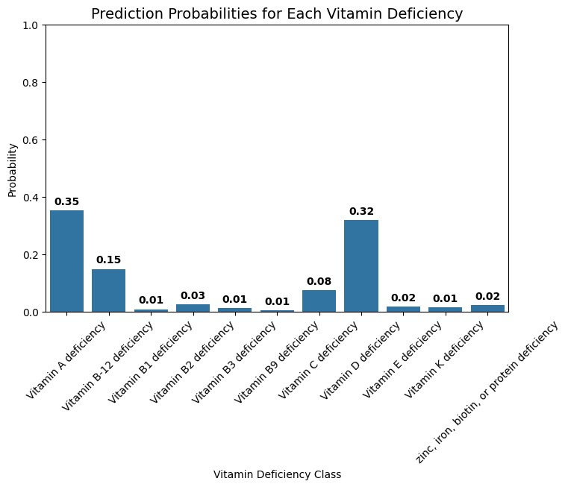
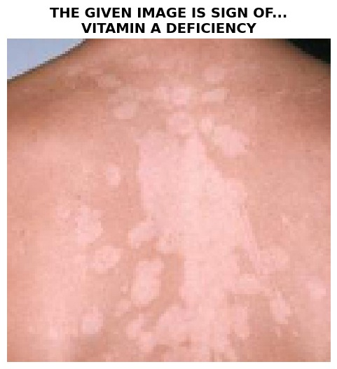
Results

Slide 11
Tools and technologies
Python Used as the main programming language for developing the deep learning model.
TensorFlow & Keras Used to build and train the CNN deep learning model for vitamin deficiency detection.
NumPy Used for numerical computations and array processing.
Matplotlib & Seaborn Used to visualize results such as graphs and prediction probabilities.
ImageDataGenerator Used for loading and preprocessing image datasets.
GoogleColab Used as the development environment to run and train the model.

Slide 12
Hardware Requirements
Laptop / Desktop with GPU For faster training.
Processor: Intel i5 / i7 or higher.
RAM: Minimum 8 GB (16 GB recommended).
Storage: 256 GB or higher.
GPU: Google Colab GPU for faster model training

Slide 13
Software Requirements
Operating System: Windows / Linux / macOS
Programming Language: Python 3.x
Libraries: TensorFlow, Keras, NumPy, Matplotlib.
Development Tools: Google Colab / Jupyter Notebook
Dataset: Image dataset of vitamin deficiency symptoms for model training.

Slide 14
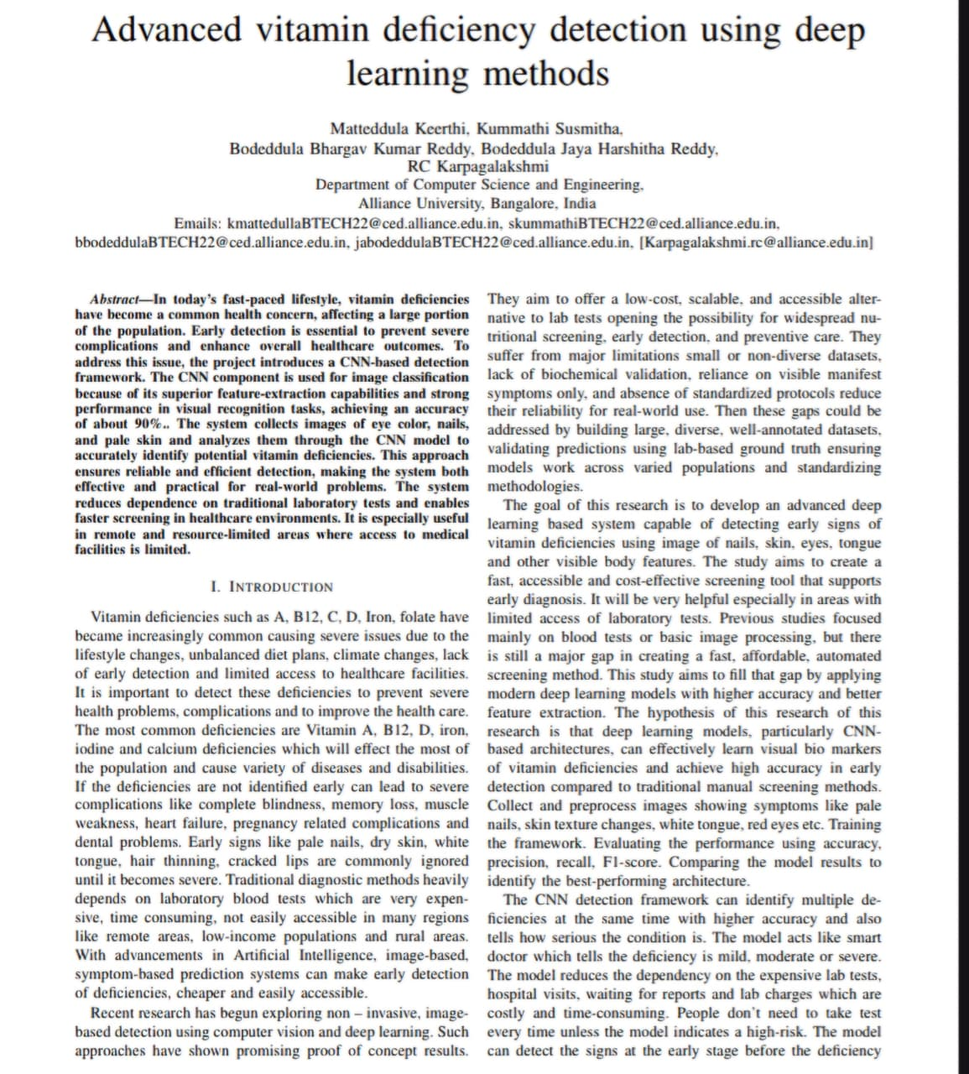
Research paper status

Slide 15

Guide approval

Slide 16


